Slide 1
Advanced Java
Người thực hiện: nguyễn thanh tâm
Mentor hướng dẫn: trương minh tuấn

Slide 2
Enum
public enum OrderStatus {
// VALUE // ORDINAL
WAITING_CONFIRMATION, // ordinal 0
WAITING_PICKUP, // ordinal 1
IN_PROGRESS, // ordinal 2
DELIVERED, // ordinal 3
COMPLETED, // ordinal 4
CANCELED, // ordinal 5
RETURNED, // ordinal 6
REFUND_SUCCESSFUL // ordinal 7
}

Slide 3
Enum
@Enumerated() ⬄ @Enumerated(EnumType.ORDINAL)
@Enumerated(EnumType.STRING)

Slide 4
Enum - Enumerated()
@Entity
@Table(name = "Orders")
public class Order {
@Id
@GeneratedValue(strategy = GenerationType.IDENTITY)
private long id;
@Enumerated()
private OrderStatus status;
public Order() {
this.setStatus(OrderStatus.WAITING_CONFIRMATION);
}
public void setStatus(OrderStatus status) {
this.status = status;
}
}
public static void main(String[] args) {
OrderService orderService = new ServiceImpl();
Order order1 = new Order();
Order order2 = new Order();
order1 = orderService.save(order1);
order2 = orderService.save(order2);
orderService.findAll().forEach(order -> System.out.println(order));
order1.setStatus(OrderStatus.COMPLETED);
orderService.save(order1);
orderService.findAll().forEach(order -> System.out.println(order));
}

Slide 5
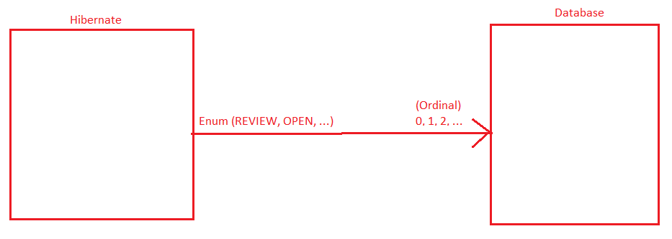
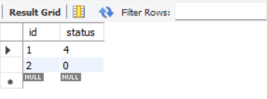
Enum – Enumerated()
SELECT * FROM dbdemo.orders;

Slide 6
Enum – Enumeration(EnumType.STRING)
@Entity
@Table(name = "Orders")
public class Order {
@Id
@GeneratedValue(strategy = GenerationType.IDENTITY)
private long id;
@Enumerated(EnumType.STRING)
private OrderStatus status;
public Order() {
this.setStatus(OrderStatus.WAITING_CONFIRMATION);
}
public void setStatus(OrderStatus status) {
this.status = status;
}
}
public static void main(String[] args) {
OrderService orderService = new ServiceImpl();
Order order1 = new Order();
Order order2 = new Order();
order1 = orderService.save(order1);
order2 = orderService.save(order2);
orderService.findAll().forEach(order -> System.out.println(order));
order1.setStatus(OrderStatus.COMPLETED);
orderService.save(order1);
orderService.findAll().forEach(order -> System.out.println(order));
}

Slide 7
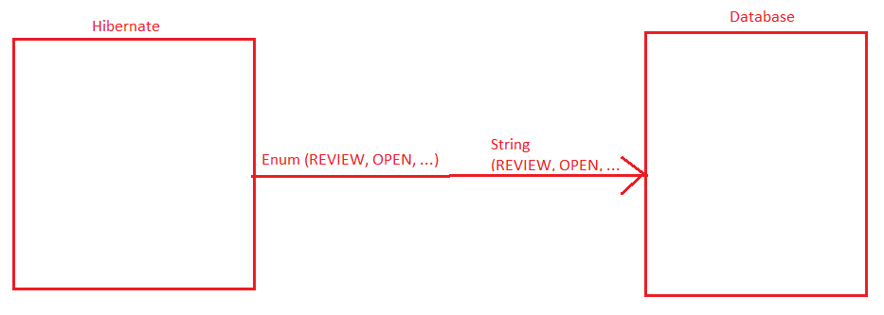

Enum – Enumerated()
SELECT * FROM dbdemo.orders;

Slide 8
Sử dụng ORDINAL hay STRING?
ORDINAL
STRING

Slide 9
Generator
Tạo dữ liệu tự động
@GeneratedValue(strategy, generator)
  GenerationType.IDENTITY
  GenerationType.SEQUENCE
  GenerationType.UUID
  GenerationType.AUTO (default)
  Custom Generator

Slide 10
Generator IDENTITY
@GeneratedValue(strategy = GenerationType.IDENTITY)
Tạo dữ liệu dạng số nguyên tăng dần bắt đầu từ 1

Slide 11

Generator IDENTITY
@Entity
@Table(name = "Orders")
public class Order {
@Id
@GeneratedValue(strategy = GenerationType.IDENTITY)
private long id;
}

Slide 12
Delete Item IDENTITY
1 | 2 | 3 | 4
Delete Item 4
1 | 2 | 3
Insert New Item
1 | 2 | 3 |  | 5
Vấn đề vượt quá giới hạn kiểu dữ liệu

Slide 13
Generator UUID
@Entity
@Table(name = "Orders")
public class Order {
@Id
@GeneratedValue(strategy = GenerationType.UUID)
private UUID id;
}

Slide 14
Generator SEQUENCE
@Entity
@Table(name = "Orders")
public class Order {
@Id
@GenericGenerator(
name = "sequence-generator",
strategy = "org.hibernate.id.enhanced.SequenceStyleGenerator",
parameters = {
@org.hibernate.annotations.Parameter(name = "sequence_name", value = "order_sequence"),
@org.hibernate.annotations.Parameter(name = "initial_value", value = "5"),
@org.hibernate.annotations.Parameter(name = "increment_size", value = "1")
}
)
@GeneratedValue(strategy = GenerationType.SEQUENCE, generator = "sequence-generator")
private long id;
}

Slide 15
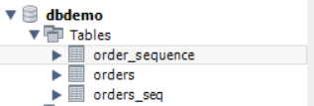
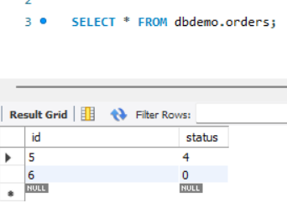
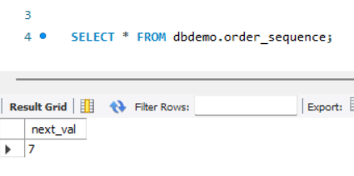
Generator SEQUENCE

Slide 16

Generator Auto
@Id
@GeneratedValue(strategy = GenerationType.AUTO)
private long id;
@Id
@GeneratedValue(strategy = GenerationType.AUTO)
private long id;

Slide 17
Generator Custom

Slide 18
Generator
Làm thế nào để lấy ra một record với filed generate?
Có một Product có id được tạo tự động. Sau khi create một product làm thế nào để query lấy ra product đó hiển thị lên giao diện
findById(<id>) ?
findAll() ?

Slide 19
Primary Key
Single primary key
Multiple primary key

Slide 20
Primary Key – Single
@Id
@Entity
@Table(name = "Orders")
public class Order {
@Id
@GeneratedValue(strategy = GenerationType.IDENTITY)
private long id;
}

Slide 21
Primary Key - Multiple
Cách 1: Sử dụng Embedable và EmbeddedId
@Embeddable
public class OrderDetailId implements Serializable {
@Column(name = "order_id")
private long orderId;
@Column(name = "product_id")
private long productId;
public OrderDetailId(long orderId, long productId) {
this.orderId = orderId;
this.productId = productId;
}
public OrderDetailId() {
}
}
@Entity
@Table(name = "order_details")
public class OrderDetail {
@EmbeddedId
private OrderDetailId orderDetailId;
public OrderDetail() {
}
public OrderDetail(OrderDetailId orderDetailId) {
this.orderDetailId = orderDetailId;
}
}

Slide 22

Primary Key - Multiple
public static void main(String[] args) {
OrderDetailService orderDetailService = new OrderDetailServiceImpl();
OrderDetail orderDetail = new OrderDetail(new OrderDetailId(1, 2));
orderDetailService.save(orderDetail);
}

Slide 23
Primary Key - Multiple
@Entity
@Table(name = "order_details")
@IdClass(OrderDetailId2.class)
public class OrderDetail {
@Id
@Column(name = "order_id")
private long orderId;
@Id
@Column(name = "product_id")
private long productId;
public OrderDetail() { }
public OrderDetail(long orderId, long productId) {
this.orderId = orderId;
this.productId = productId;
}
}
Cách 2: Sử dụng Embedable và IdClass
@Embeddable
public class OrderDetailId2 implements Serializable {
@Column(name = "order_id")
private long orderId;
@Column(name = "product_id")
private long productId;
}

Slide 24

Primary Key - Multiple
public class Main {
public static void main(String[] args) {
OrderService orderService = new ServiceImpl();
OrderDetailService orderDetailService = new OrderDetailServiceImpl();
OrderDetail orderDetail = new OrderDetail(1, 2);
orderDetailService.save(orderDetail);
}
}

Slide 25
Many – Many
Không sử dụng IdClass, EmbeddedId có được không?

Slide 26
Many - Many
Tại sao phải sử dụng @IdClass @EmbeddedId?

Slide 27
One - One
1 Way
2 Way

Slide 28
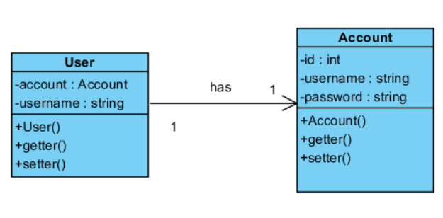
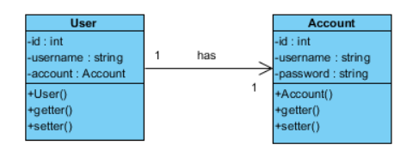
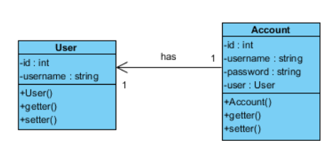
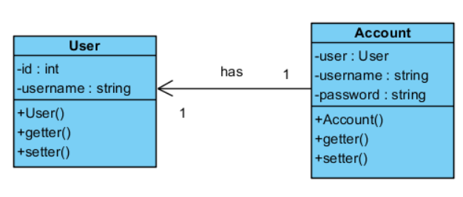
One - One
1 Way

Slide 29
One – One
@Entity
@Table(name = "users")
public class User {
@Id
@GeneratedValue(strategy = GenerationType.IDENTITY)
private int id;
@Column(name = "full_name")
private String fullName;
@OneToOne
@JoinColumn(name = "accountId")
private Account account;
public User() { }
public User(String fullName, Account account) {
setFullName(fullName);
setAccount(account);
}
}
@Entity
@Table(name = "accounts")
public class Account {
@Id
@GeneratedValue(strategy = GenerationType.IDENTITY)
private int id;
private String username;
private String password;
public Account() {
}
public Account(String username, String password) {
setUsername(username);
setPassword(password);
}
Ex10

Slide 30
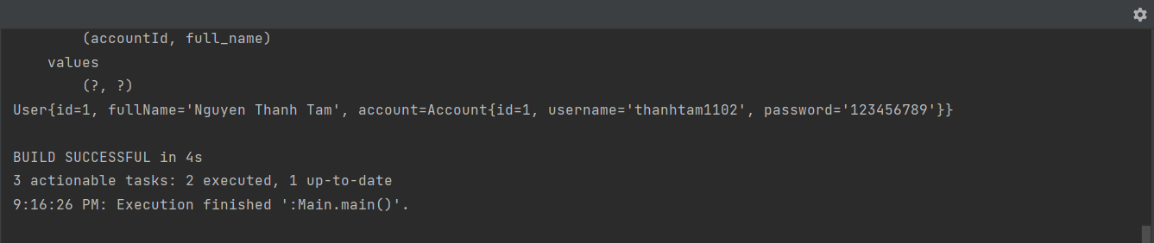
One – One
public static void main(String[] args) {
AccountService accountService = new AccountServiceImpl();
UserService userService = new UserServiceImpl();
Account account = new Account("thanhtam1102", "123456789");
account = accountService.save(account);
User user = new User("Nguyen Thanh Tam", account);
user = userService.save(user);
System.out.println(user.getAccount());
}

Slide 31
One – One
@Entity
@Table(name = "users")
public class User {
@Id
@GeneratedValue(strategy = GenerationType.IDENTITY)
private int id;
@Column(name = "full_name")
private String fullName;
public User() {
}
public User(String fullName) {
setFullName(fullName);
}
@Entity
@Table(name = "accounts")
public class Account {
@Id
@GeneratedValue(strategy = GenerationType.IDENTITY)
private int id;
private String username;
private String password;
@OneToOne
@JoinColumn(name = "userId", referencedColumnName = "id", unique = true)
private User user;
public Account() { }
public Account(String username, String password, User user) {
setUsername(username);
setPassword(password);
setUser(user);
}

Slide 32
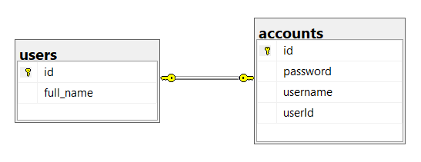
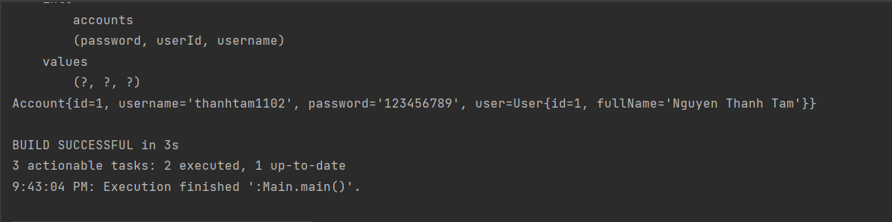
One – One
public static void main(String[] args) {
AccountService accountService = new AccountServiceImpl();
UserService userService = new UserServiceImpl();
User user = new User("Nguyen Thanh Tam");
user = userService.save(user);
Account account = new Account("thanhtam1102", "123456789", user);
account = accountService.save(account);
System.out.println(account.toString());
}

Slide 33
One – One

Slide 34
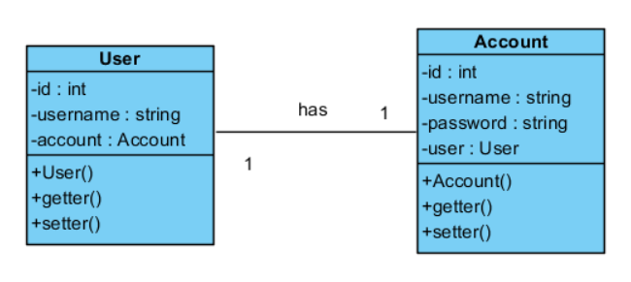
One - One
2 Way

Slide 35
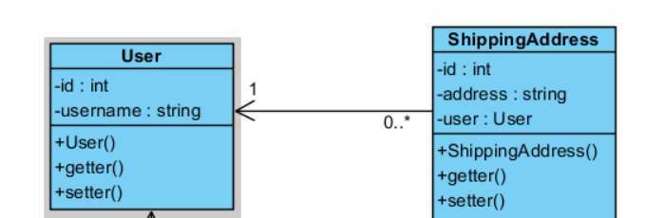
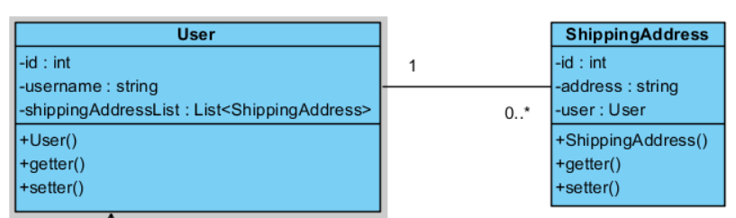
One - Many

Slide 36
One - Many
@Entity
@Table(name = "shipping_addresses")
public class ShippingAddress {
@Id
@GeneratedValue(strategy = GenerationType.IDENTITY)
private int id;
private String address;
@ManyToOne
@JoinColumn(name = "user_id")
private User user;
public ShippingAddress() {
}
public ShippingAddress(String address, User user) {
setAddress(address);
setUser(user);
}
@Entity
@Table(name = "users")
public class User {
@Id
@GeneratedValue(strategy = GenerationType.IDENTITY)
private int id;
@Column(name = "full_name")
private String fullName;
public User() {
}
public User(String fullName) {
setFullName(fullName);
}

Slide 37
One - Many
public static void main(String[] args) {
UserService userService = new UserServiceImpl();
ShippingAddressService shippingAddressService = new ShippingAddressServiceImpl();
User user = new User("Nguyen Thanh Tam");
user = userService.save(user);
ShippingAddress shippingAddress1 = new ShippingAddress("Shipping Address 1", user);
ShippingAddress shippingAddress2 = new ShippingAddress("Shipping Address 2", user);
shippingAddress1 = shippingAddressService.save(shippingAddress1);
shippingAddress2 = shippingAddressService.save(shippingAddress2);
System.out.println(shippingAddress1);
System.out.println(shippingAddress2);
}

Slide 38
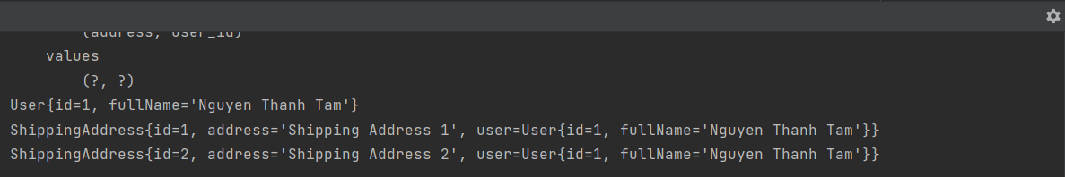
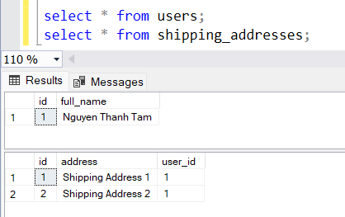
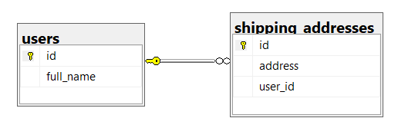
One - Many

Slide 39
One - Many
@Entity
@Table(name = "users")
public class User {
@Id
@GeneratedValue(strategy = GenerationType.IDENTITY)
private int id;
@Column(name = "full_name")
private String fullName;
@OneToMany(mappedBy = "user", fetch = FetchType.EAGER)
private List<ShippingAddress> shippingAddresses;
public User() {
}
public User(String fullName) {
setFullName(fullName);
}
@Entity
@Table(name = "shipping_addresses")
public class ShippingAddress {
@Id
@GeneratedValue(strategy = GenerationType.IDENTITY)
private int id;
private String address;
@ManyToOne
@JoinColumn(name = "user_id")
private User user;
public ShippingAddress() {
}
public ShippingAddress(String address, User user) {
setAddress(address);
setUser(user);
}

Slide 40
One - Many
public static void main(String[] args) {
UserService userService = new UserServiceImpl();
ShippingAddressService shippingAddressService = new ShippingAddressServiceImpl();
User user = new User("Nguyen Thanh Tam");
user = userService.save(user);
ShippingAddress shippingAddress1 = new ShippingAddress("Shipping Address 1", user);
ShippingAddress shippingAddress2 = new ShippingAddress("Shipping Address 2", user);
shippingAddress1 = shippingAddressService.save(shippingAddress1);
shippingAddress2 = shippingAddressService.save(shippingAddress2);
System.out.println(shippingAddress1);
System.out.println(shippingAddress2);
user = userService.findById(user.getId());
System.out.println(user);
}

Slide 41
One - Many

Slide 42
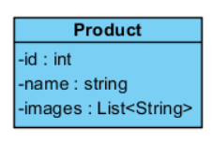
One – Many Collection
@Entity
@Table(name = "products")
public class Product {
@Id
@GeneratedValue(strategy = GenerationType.IDENTITY)
private long id;
private String name;
@ElementCollection(fetch = FetchType.EAGER)
@CollectionTable(
name = "images",
joinColumns = @JoinColumn(name = "product_id")
)
@Column(name = "image")
private List<String> images;
public Product() { }
public Product(String name, List<String> images) {
this.name = name;
this.images = images;
}

Slide 43
One – Many Collection
public static void main(String[] args) {
ProductService productService = new ProductServiceImpl();
Product product = new Product(
"New Product",
Arrays.asList("image1", "image2", "image3")
);
product = productService.save(product);
System.out.println(product);
}

Slide 44
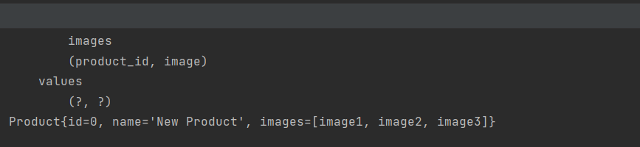
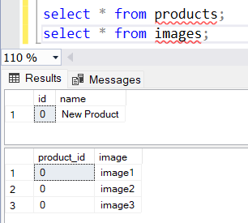
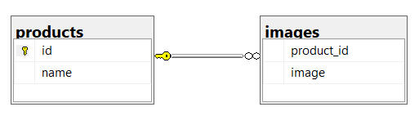
One – Many Collection

Slide 45
One – Many Collection
Có thể tạo Collection table nhiều filed hay không?
Có nên tạo Collection table nhiều filed hay không?

Slide 46
Many - Many
@ManyToMany
@IdClass
@EmbeddedId

Slide 47
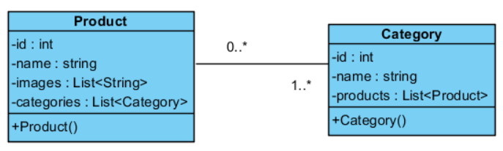
Many - Many
@Entity
@Table(name = "categories")
public class Category {
@Id
@GeneratedValue(strategy = GenerationType.IDENTITY)
private int id;
private String name;
@ManyToMany(fetch = FetchType.EAGER)
@JoinTable(
name = "products_categories",
joinColumns =@JoinColumn(name = "category_id"),
inverseJoinColumns = @JoinColumn(name = "product_id")
)
private List<Product> products;
public Category() { }
public Category(String name, List<Product> products) {
setName(name);
setProducts(products);
}
@Entity
@Table(name = "products")
public class Product {
@Id
@GeneratedValue(strategy = GenerationType.IDENTITY)
private long id;
private String name;
@ManyToMany(mappedBy = "products", fetch = FetchType.EAGER)
private List<Category> categories;
public Product() {
}
public Product(String name, List<String> images) {
this.name = name;
this.images = images;
}

Slide 48
Many - Many
category = categoryService.save(category);
System.out.println("Danh mục 1");
System.out.println(category.getProducts());
category1 = categoryService.save(category1);
System.out.println("Danh mục 2");
System.out.println(category1.getProducts());
product = productService.findById(product.getId());
System.out.println("Sản phẩm 1");
System.out.println(product.getCategories());
product1 = productService.findById(product1.getId());
System.out.println("Sản phẩm 2");
System.out.println(product1.getCategories());
product2 = productService.findById(product2.getId());
System.out.println("Sản phẩm 3");
System.out.println(product2.getCategories());
}
public static void main(String[] args) {
ProductService productService = new ProductServiceImpl();
CategoryService categoryService = new CategoryServiceImpl();
Product product = new Product("Sản phẩm 1", Arrays.asList("image1", "image2", "image3"));
Product product1 = new Product("Sản phẩm 2", null);
Product product2 = new Product("Sản phẩm 3", null);
product = productService.save(product);
product1 = productService.save(product1);
product2 = productService.save(product2);
Category category = new Category("Danh mục 1", Arrays.asList(product, product1));
Category category1 = new Category("Danh mục 2", Arrays.asList(product, product2));

Slide 49
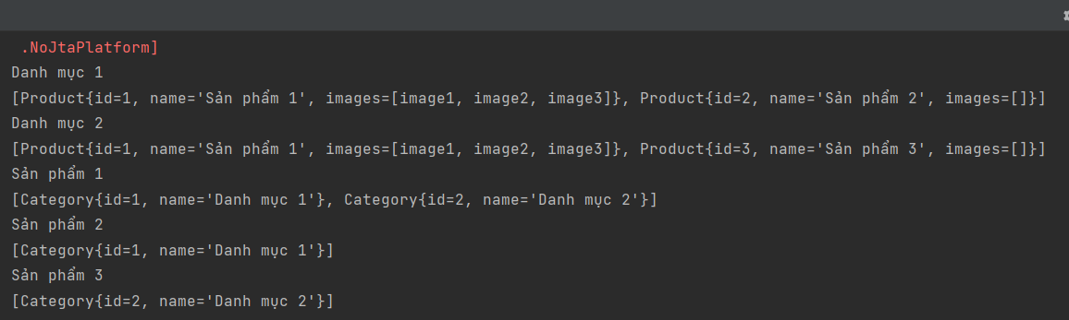
Many - Many

Slide 50
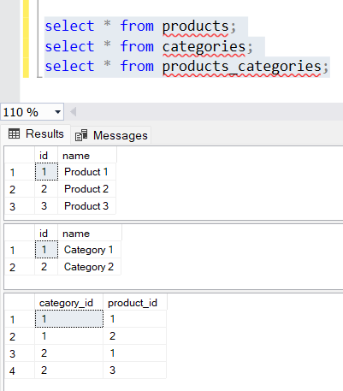
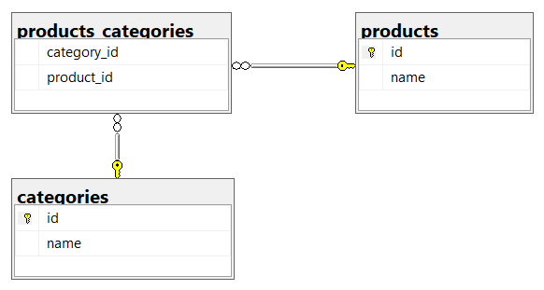
Many - Many

Slide 51
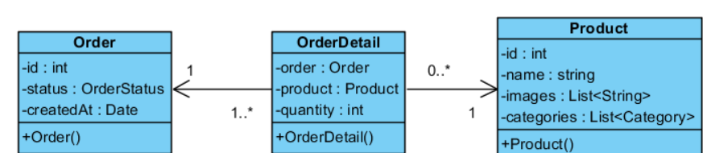
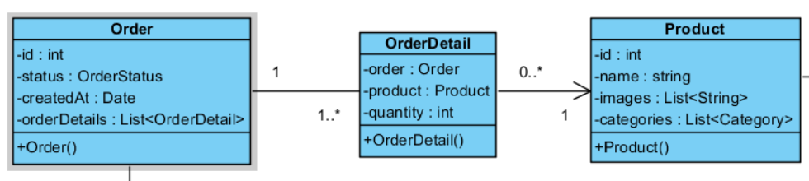
Many - Many

Slide 52
Many - Many
@Entity
@Table(name = "order_details")
@IdClass(OrderDetailId.class)
public class OrderDetail {
@Id
@ManyToOne
@JoinColumn(name = "order_id")
private Order order;
@Id
@ManyToOne
@JoinColumn(name = "product_id")
private Product product;
@Column(nullable = false)
private int quantity;
public OrderDetail() { }
public OrderDetail(Order order, Product product, int quantity) {
setOrder(order);
setProduct(product);
setQuantity(quantity);
}
@Entity
@Table(name = "orders")
public class Order {
@Id
@GeneratedValue(strategy = GenerationType.IDENTITY)
private long id;
@Enumerated(EnumType.STRING)
private OrderStatus status;
@CreationTimestamp
private Date createdAt;
public Order() {
setStatus(OrderStatus.WAITING_CONFIRMATION);
}

Slide 53
Many - Many
OrderService orderService = new OrderServiceImpl();
OrderDetailService orderDetailService = new OrderDetailServiceImpl();
Order order = new Order();
order = orderService.save(order);
OrderDetail orderDetail1 = new OrderDetail(order, product1, 1);
OrderDetail orderDetail2 = new OrderDetail(order, product2, 2);
orderDetail1 = orderDetailService.save(orderDetail1);
orderDetail2 = orderDetailService.save(orderDetail2);
System.out.println(order);
System.out.println(orderDetail1);
System.out.println(orderDetail2);

Slide 54
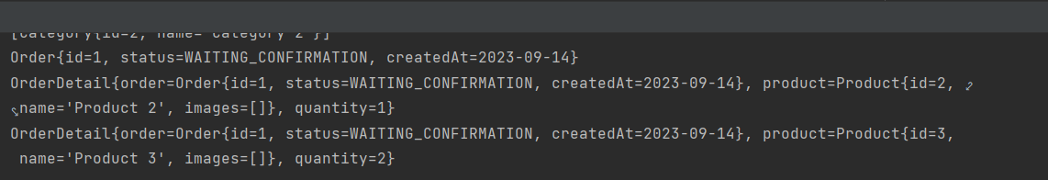
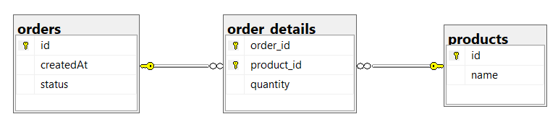
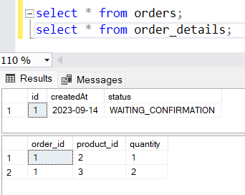
Many - Many

Slide 55
Many - Many
@Entity
@Table(name = "order_details")
@IdClass(OrderDetailId.class)
public class OrderDetail {
@Id
@ManyToOne
@JoinColumn(name = "order_id")
private Order order;
@Id
@ManyToOne
@JoinColumn(name = "product_id")
private Product product;
@Column(nullable = false)
private int quantity;
public OrderDetail() { }
public OrderDetail(Order order, Product product, int quantity) {
setOrder(order);
setProduct(product);
setQuantity(quantity);
}
@Entity
@Table(name = "orders")
public class Order {
@Id
@GeneratedValue(strategy = GenerationType.IDENTITY)
private long id;
@Enumerated(EnumType.STRING)
private OrderStatus status;
@CreationTimestamp
private Date createdAt;
@OneToMany(mappedBy = "order", fetch = FetchType.EAGER)
private List<OrderDetail> orderDetails;
public Order() {
setStatus(OrderStatus.WAITING_CONFIRMATION);
}

Slide 56
Many - Many
OrderService orderService = new OrderServiceImpl();
OrderDetailService orderDetailService = new OrderDetailServiceImpl();
Order order = new Order();
order = orderService.save(order);
OrderDetail orderDetail1 = new OrderDetail(order, product1, 1);
OrderDetail orderDetail2 = new OrderDetail(order, product2, 2);
orderDetail1 = orderDetailService.save(orderDetail1);
orderDetail2 = orderDetailService.save(orderDetail2);
order = orderService.findById(order.getId());
System.out.println(order);
System.out.println("Order Details");
System.out.println(order.getOrderDetails());

Slide 57
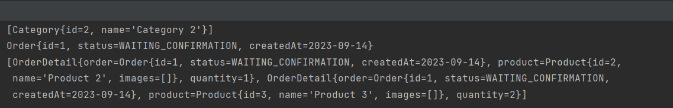
Many - Many

Slide 58
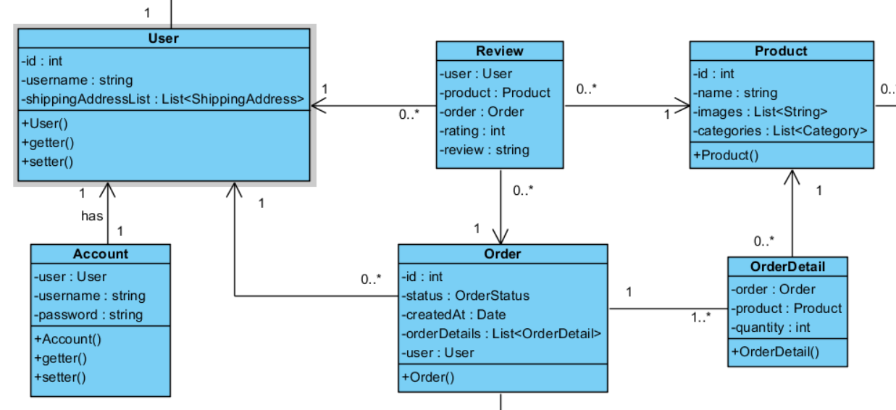
Many - Many

Slide 59
Many - Many
@Entity
@Table(name = "reviews")
public class Review {
@EmbeddedId
private ReviewId id;
@MapsId("user_id")
@ManyToOne
@JoinColumn(name = "user_id")
private User user;
@MapsId("order_id")
@ManyToOne
@JoinColumn(name = "order_id")
private Order order;
@MapsId("product_id")
@ManyToOne
@JoinColumn(name = "product_id")
private Product product;
@Column(nullable = false)
private int rating;
private String review;
@Embeddable
public class ReviewId implements Serializable {
@Column(name = "user_id")
private int user;
@Column(name = "order_id")
private long order;
@Column(name = "product_id")
private long product;
public ReviewId() {
}
public ReviewId(int user, long order, long product) {
this.user = user;
this.order = order;
this.product = product;
}
public Review() { }
public Review(User user, Order order, Product product, int rating, String review) {
this.id = new ReviewId(user.getId(), order.getId(), product.getId());
this.user = user;
this.order = order;
this.product = product;
this.rating = rating;
this.review = review;
}

Slide 60
Many - Many
UserService userService = new UserServiceImpl();
OrderService orderService = new OrderServiceImpl();
ReviewService reviewService = new ReviewServiceImpl();
User user = new User("Nguyen Thanh Tam");
user = userService.save(user);
Order order = new Order(user);
order = orderService.save(order);
Review review = new Review(user, order, product, 5, "Good!!!");
review = reviewService.save(review);
System.out.println(user);
System.out.println(order);
System.out.println(review);
review = reviewService.findById(review.getId());
System.out.println(review);

Slide 61
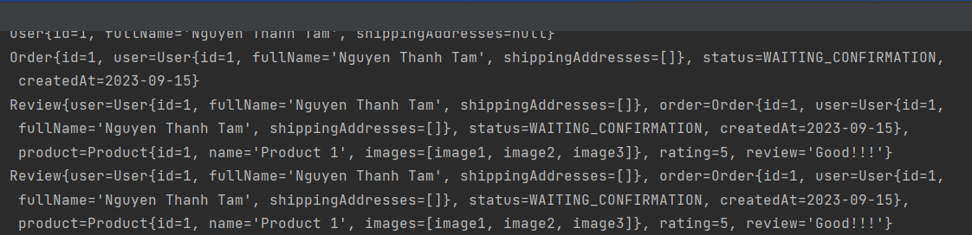
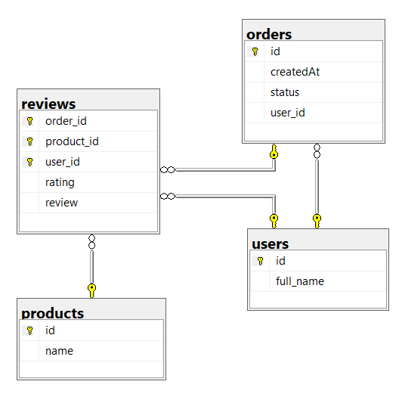
Many - Many

Slide 62
Many - Many
Nên sử dụng mối quan hệ 1 chiều hay 2 chiều?

Slide 63
Many - Billion

Slide 64
Inheritance
@Inheritance(strategy = InheritanceType.JOINED)
@Inheritance(strategy = InheritanceType.SINGLE_TABLE)
@MappedSuperclass
@Inheritance(strategy = InheritanceType.TABLE_PER_CLASS)

Slide 65
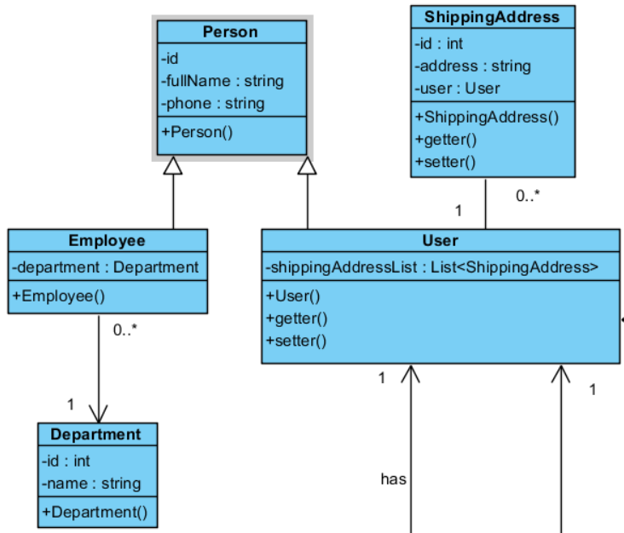
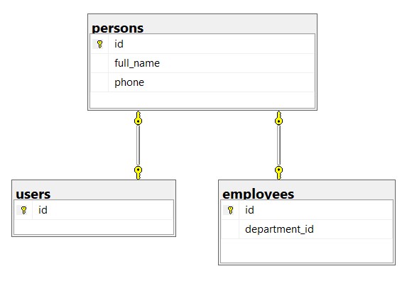
Inheritance
@Inheritance(strategy = InheritanceType.JOINED)

Slide 66
Inheritance
@Entity
@Table(name = "users")
public class User extends Person {
@OneToMany(mappedBy = "user", fetch = FetchType.EAGER)
private List<ShippingAddress> shippingAddresses;
public User() {
}
public User(String fullName, String phone) {
super(fullName, phone);
}
@Entity
@Table(name = "persons")
@Inheritance(strategy = InheritanceType.JOINED)
public abstract class Person {
@Id
@GeneratedValue(strategy = GenerationType.IDENTITY)
private int id;
@Column(name = "full_name", nullable = false)
private String fullName;
@Column(nullable = false)
private String phone;
public Person() {}
public Person(String fullName, String phone) {
setFullName(fullName);
setPhone(phone);
}
@Entity
@Table(name = "employees")
public class Employee extends Person {
@ManyToOne
@JoinColumn(name = "department_id", nullable = false)
private Department department;
public Employee() {
}
public Employee(String fullName, String phone, Department department) {
super(fullName, phone);
setDepartment(department);
}

Slide 67
Inheritance
public static void main(String[] args) {
UserService userService = new UserServiceImpl();
EmployeeService employeeService = new EmployeeServiceImpl();
DepartmentService departmentService = new DepartmentServiceImpl();
User user = new User("Nguyen Thanh Tam", "0123456789");
user = userService.save(user);
Department department = new Department("Development Room");
department = departmentService.save(department);
Employee employee = new Employee("Nguyen Thanh Tam", "0123456789", department);
employee = employeeService.save(employee);
System.out.println(user);
System.out.println(employee);
}

Slide 68
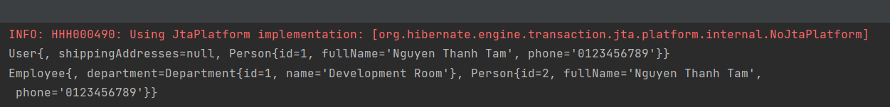
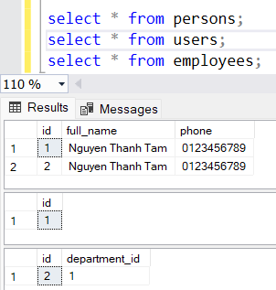
Inheritance

Slide 69
Inheritance
Ưu điểm:
  Table được chuẩn hóa, không gây dư thừa, trùng lắp dữ liệu
  Có thể config column not null, unique
Nhược điểm:
  Hiệu năng không tốt, cần join khi query

Slide 70
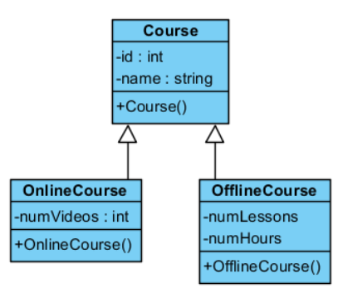
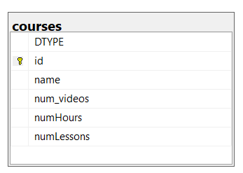
Inheritance
@Inheritance(strategy = InheritanceType.SINGLE_TABLE)

Slide 71
Inheritance
@Entity
public class OnlineCourse extends Course {
@Column(name = "num_videos")
private int numVideos;
public OnlineCourse() { }
public OnlineCourse(String name, int numVideos) {
super(name);
setNumVideos(numVideos);
}
@Inheritance(strategy = InheritanceType.SINGLE_TABLE)
@Entity
@Table(name = "courses")
public class Course {
@Id
@GeneratedValue(strategy = GenerationType.IDENTITY)
private int id;
@Column(nullable = false)
private String name;
public Course() {}
public Course(String name) {
this.name = name;
}
@Entity
public class OfflineCourse extends Course {
private int numLessons;
private float numHours;
public OfflineCourse() { }
public OfflineCourse(String name, int numLessons, float numHours) {
super(name);
setNumLessons(numLessons);
setNumHours(numHours);
}

Slide 72
Inheritance
public static void main(String[] args) {
OfflineCourseService offlineCourseService = new OfflineCourseServiceImpl();
OnlineCourseService onlineCourseService = new OnlineCourseServiceImpl();
OnlineCourse onlineCourse = new OnlineCourse("Advanced Java", 5);
onlineCourse = onlineCourseService.save(onlineCourse);
OfflineCourse offlineCourse = new OfflineCourse("Advanced Java", 5, 12);
offlineCourse = offlineCourseService.save(offlineCourse);
System.out.println(onlineCourse);
System.out.println(offlineCourse);
}

Slide 73
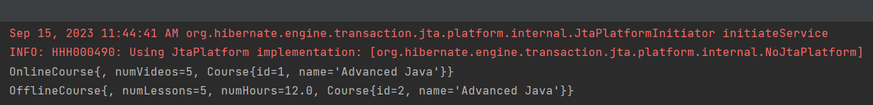
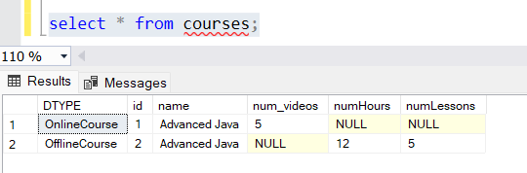
Inheritance

Slide 74

Inheritance
Parrent Class
@DiscriminatorColumn(name = "course_type", discriminatorType = DiscriminatorType.INTEGER)
Child Class
@DiscriminatorValue(value = “1")
discriminatorType
DiscriminatorType.STRING (Default)
DiscriminatorType.INTEGER
DiscriminatorType.CHAR

Slide 75
Inheritance
Ưu điểm:
  Chỉ tạo 1 table trong database
  Hiệu năng tốt do không cần Join khi query, chỉ cần query 1 table duy nhất
Nhược điểm:
  Không thể config column not null
  Không thể config unique, trùng lắp dữ liệu
  Table không được chuẩn hóa, null column

Slide 76
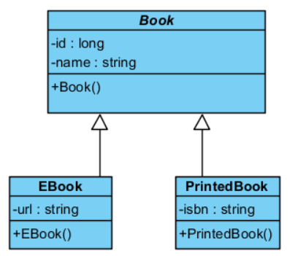
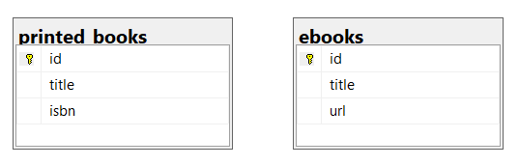
Inheritance
@MappedSuperclass

Slide 77
Inheritance
@Entity
@Table(name = "ebooks")
public class EBook extends Book {
@Id
@GeneratedValue(strategy = GenerationType.IDENTITY)
private long id;
@Column(nullable = false)
private String url;
public EBook() {
}
public EBook(String title, String url) {
super(title);
setUrl(url);
}
@Entity
@Table(name = "printed_books")
public class PrintedBook extends Book {
@Id
@GeneratedValue(strategy = GenerationType.IDENTITY)
private long id;
@Column(nullable = false)
private String isbn;
public PrintedBook() {
}
public PrintedBook(String title, String isbn) {
super(title);
setIsbn(isbn);
}
@MappedSuperclass
public abstract class Book {
@Column(nullable = false)
private String title;
public Book() {
}
public Book(String title) {
this.title = title;
}

Slide 78
Inheritance
public static void main(String[] args) {
EBookService eBookService = new EBookServiceImpl();
PrintedBookService printedBookService = new PrintedBookServiceImpl();
EBook eBook = new EBook("Advanced Java", "https://google.com");
eBook = eBookService.save(eBook);
PrintedBook printedBook = new PrintedBook("Advanced Java", "123456789");
printedBook = printedBookService.save(printedBook);
System.out.println(eBook);
System.out.println(printedBook);
}

Slide 79
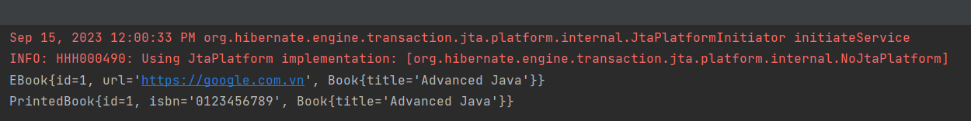
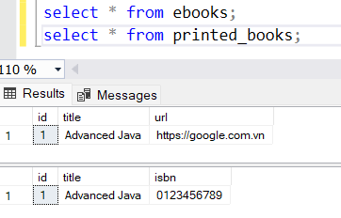
Inheritance

Slide 80
Inheritance
@Inheritance(strategy = InheritanceType.TABLE_PER_CLASS)

Slide 81
Inheritance
@Entity
@Table(name = "ebooks")
public class EBook extends Book {
@Id
private long id;
@Column(nullable = false)
private String url;
public EBook() { }
public EBook(String title, String url) {
super(title);
setUrl(url);
}
@Entity
@Inheritance(strategy = InheritanceType.TABLE_PER_CLASS)
public abstract class Book {
@Id
@GeneratedValue(strategy = GenerationType.AUTO)
private long id;
@Column(nullable = false)
private String title;
@ManyToOne
private Author author;
public Book() {}
public Book(String title) {
this.title = title;
}
@Entity
@Table(name = "printed_books")
public class PrintedBook extends Book {
@Id
private long id;
@Column(nullable = false)
private String isbn;
public PrintedBook() { }
public PrintedBook(String title, String isbn) {
super(title);
setIsbn(isbn);
}

Slide 82
Inheritance
EBookService eBookService = new EBookServiceImpl();
PrintedBookService printedBookService = new PrintedBookServiceImpl();
EBook eBook = new EBook("Basic Java", "https://google.com");
eBook = eBookService.save(eBook);
PrintedBook printedBook = new PrintedBook("Advanced Java", "123456789");
printedBook = printedBookService.save(printedBook);
eBook = eBookService.findById(eBook.getId());
printedBook = printedBookService.findById(printedBook.getId());
System.out.println(eBook);
System.out.println(printedBook);

Slide 83
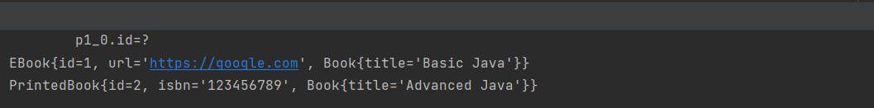
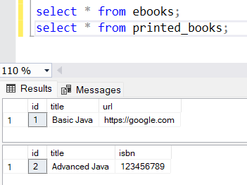
Inheritance

Slide 84
Inheritance
Advantages
  Can set NOT NULL
Disadvantages
  Table is not normalized
  Duplicated data
  Lower performance (due to additional UNION operators)

Slide 85
Fetch
FetchType.EAGER
FetchType.LAZY

Slide 86
HQL
Hiberante Query Language
HQL translate to SQL
Các từ khóa như: select, from, where,… không phân biệt chữ hoa chữ thường
Tên table, tên thuộc tính, tên column phân biệt chữ hoa chữ thường
Có thể sử dụng với Java Object, Java Constructor, Java Varriable,…

Slide 87

HQL
Select

Slide 88

HQL

Slide 89

HQL

Slide 90

HQL

Slide 91

HQL

Slide 92
SQL
Native SQL Query
Có thể sử dụng với SQL Field, SQL Table,… SQL
Call Function
Call Procedure
public List<Product> findProductsSQL() {
EntityManager em = databaseUtils.getEntityManager();
try {
return em.createNativeQuery("select * from products", Product.class).getResultList();
} catch (Exception ex) {
throw new RuntimeException(ex);
}
}

Slide 93
HQL & SQL
Nên sử dụng HQL hay SQL?

Slide 94
HQL & SQL
HQL
Select p from Product p
SQL
MS SQL
Select top 10 * from products
MY SQL
Select * from products limit 10

Slide 95
HQL & SQL
 | HQL | SQL
Tương thích | Có thể chạy trên nhiều database khác nhau, dễ dàng migrate | Chỉ chạy trên 1 database xác định
Tốc độ | Cần translate -> SQL | Không cần translate Được thực thi trực tiếp bởi JDBC
Name | Không cần quan tâm đến tên table, tên column | Cần quan tâm đến tên table, tên column Khi thay đổi tên table, tên column cần phải thay đổi query
 | Không phải query nào cũng thực hiện được | Thực hiện được tất cả các câu query

Slide 96
Thank You

